Slide 1
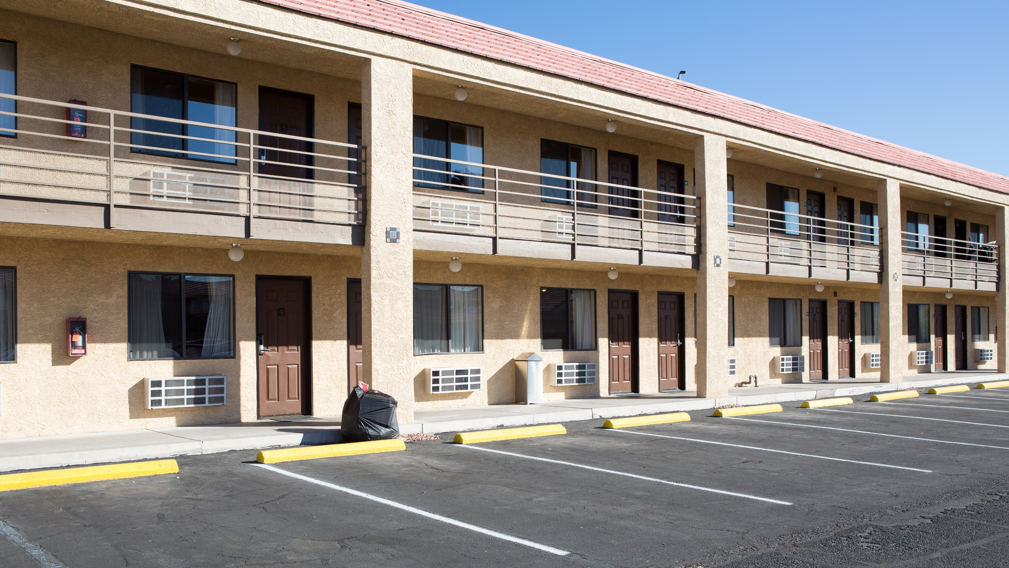
Vilicus Capital 2024 Commercial Real estate Economic Outlook

Slide 2
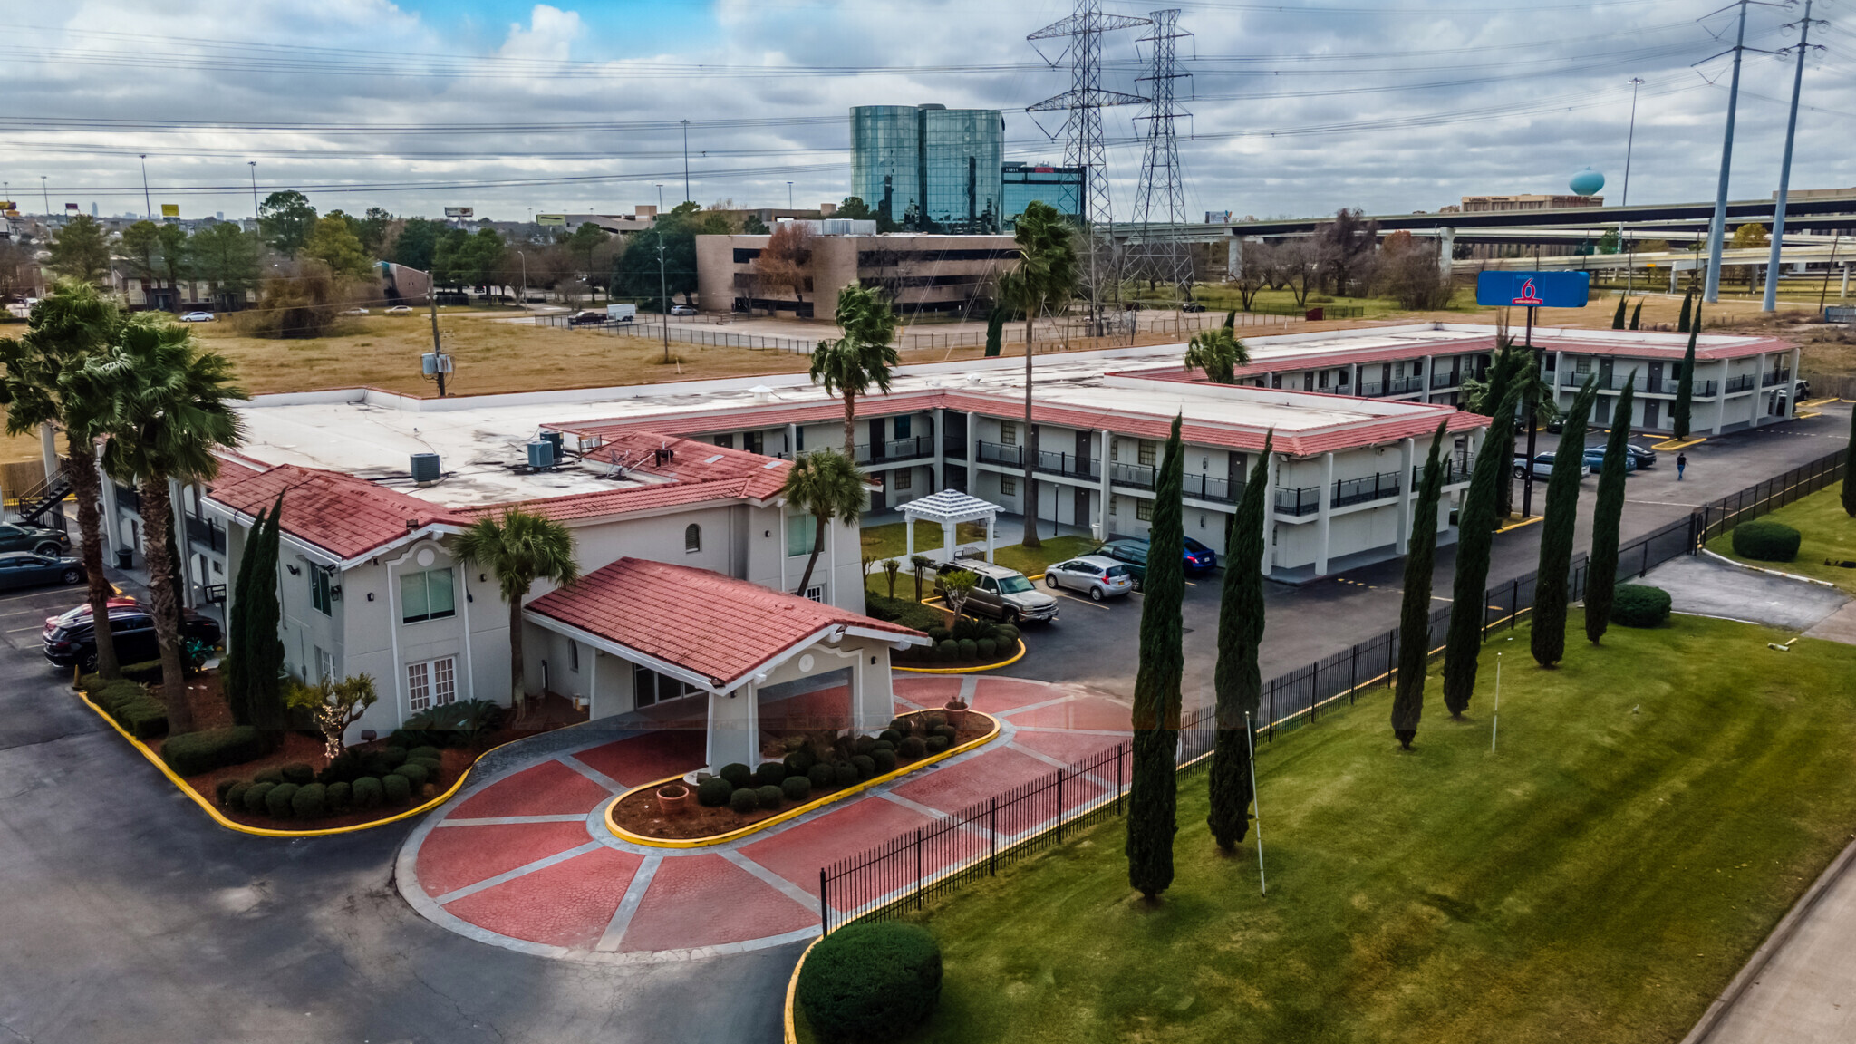
Vilicus is latin for Steward. We are exceptional stewards of investor capital .
Vilicus Capital buys hospitality properties and performs the legal and physical changes needed to transform them into hotels. We have investment options for passive investors & opportunities for active partnership and to place 1031 funds.
AlexCartwright@vilicus.capital
WWW.VILICUS.CAPITAL

Slide 3
Visit our website to join our mailing list and learn about upcoming investment opportunities
AlexCartwright@vilicus.capital
WWW.VILICUS.CAPITAL

Slide 4
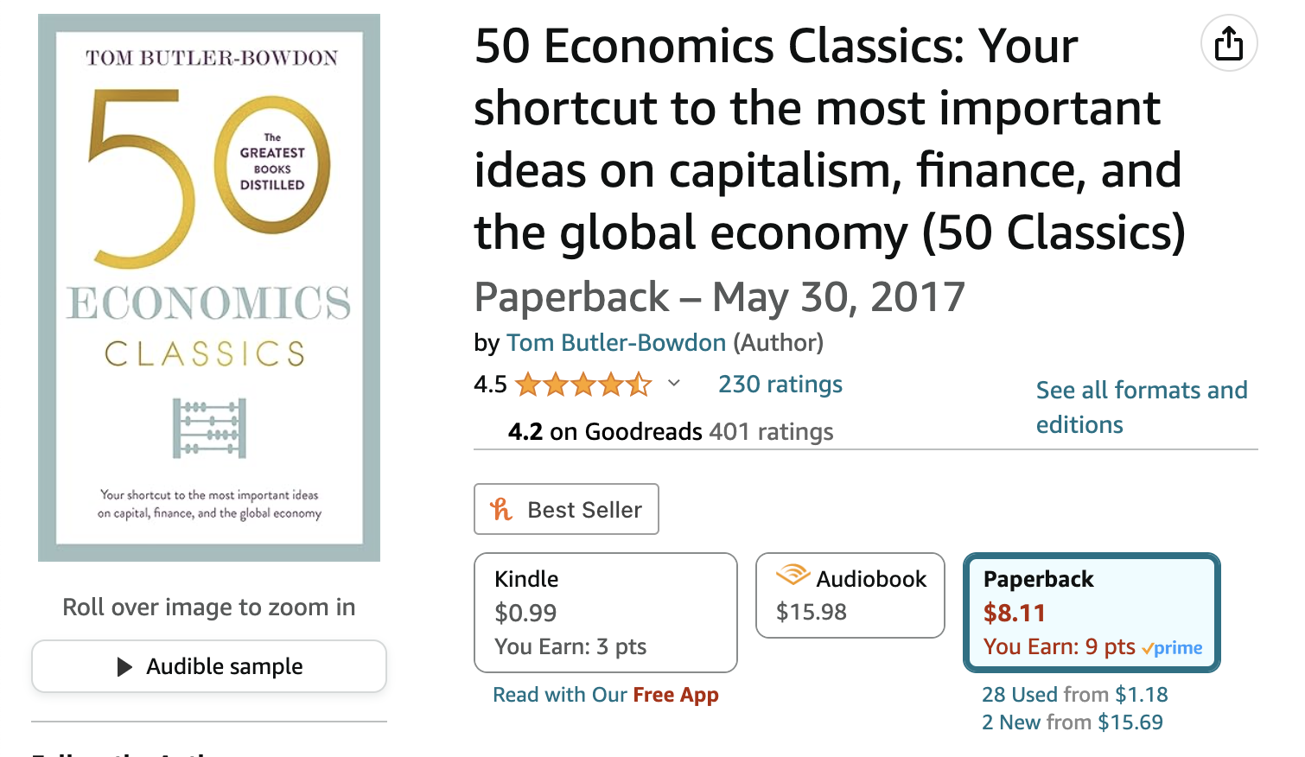
The Economic Edge: A reading group for Real Estate Entrepreneurs
Scan the QR code to become a member of our live weekly reading group where Dr. Cartwright leads participants through an economics related book that will help us become better real estate entrepreneurs.
Our next book “50 Economics Classics” is a book of 50 essays which summarize the 50 most influential books in the history of Economics.
4

Slide 5
The Economic Edge: A reading group for Real Estate Entrepreneurs
Membership includes access to live weekly meetings, access to archives of meeting recordings, supplemental readings, discussion questions and exercises, and access to an online community with all other reading group members. Membership can be canceled anytime.
5

Slide 6
Important Context to understand our current Economic state
40% of all dollars in existence have been created since 2020
Record expansion of the money supply was coupled with record government stimulus spending ($6T)
After the largest & fastest ever increase in the money supply, we experienced the fastest increase in interest rates in the last half century. Mortgage rates have been over 7% for 5 weeks in a row.
The Fed has a dual mandate: they need to achieve BOTH price stability & full employment (which is not 0% unemployment – likely around 4% unemployment)
Because wages are such a big part of inflation, lower inflation likely requires unemployment to rise (or the job market to at least slow)
Our labor market is extraordinarily tight and unemployment has not budget much as rates have increased.
Unemployment has been in high 3% for all of 2023
6

Slide 7
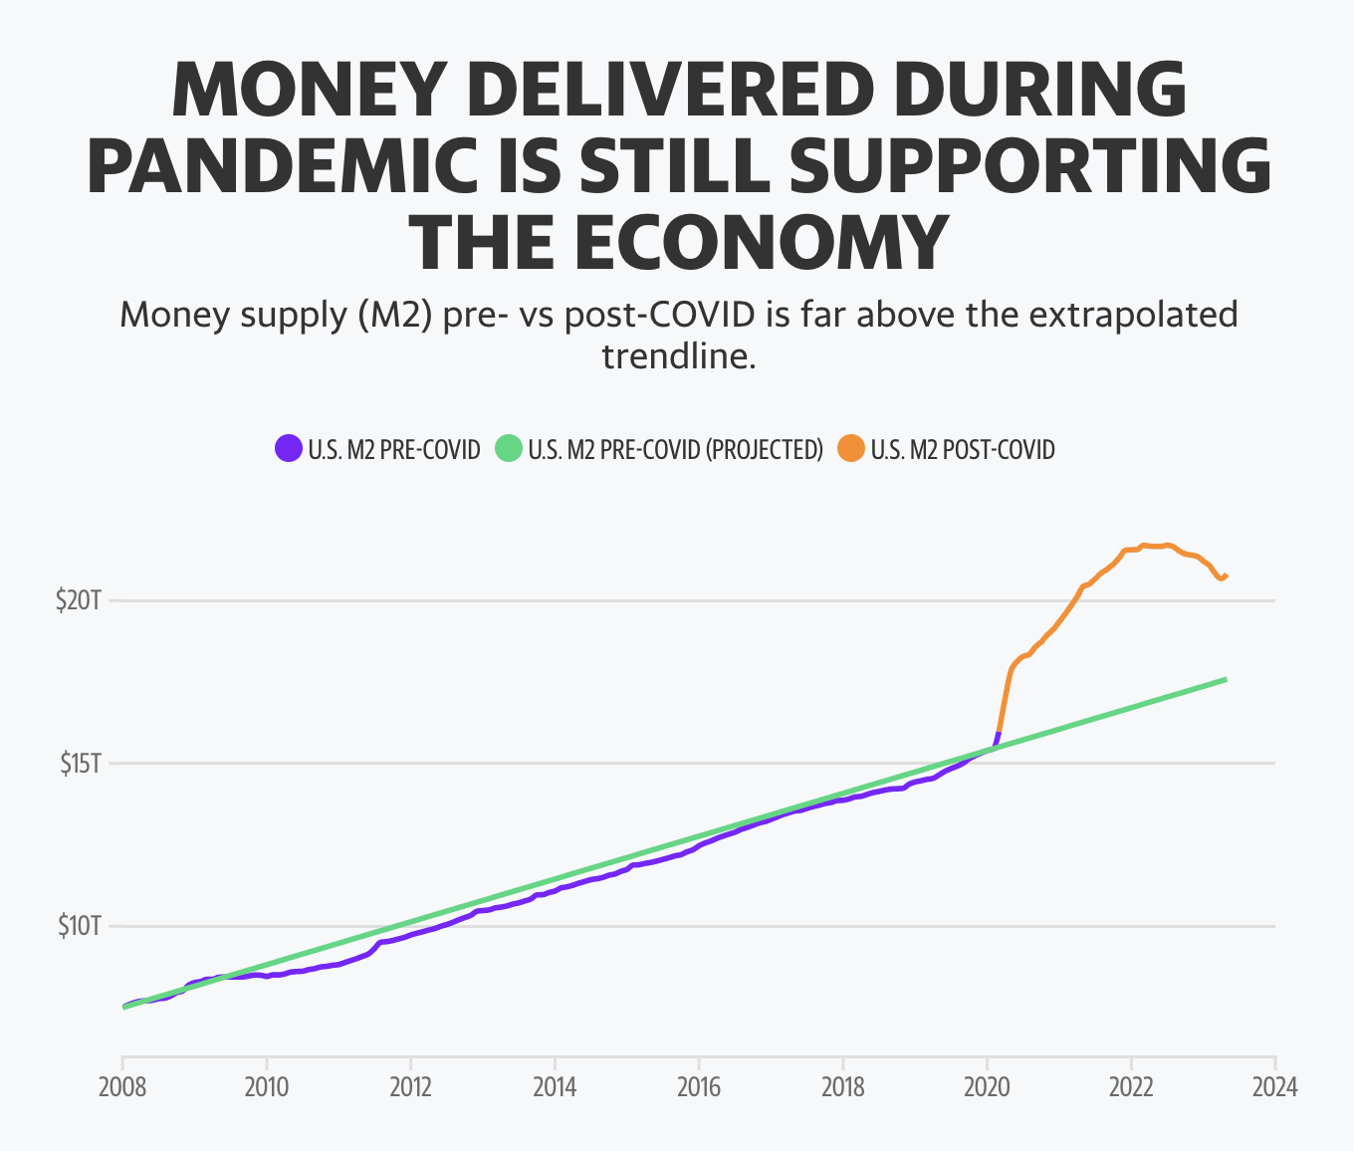
Important Context to understand our current Economic state
7

Slide 8
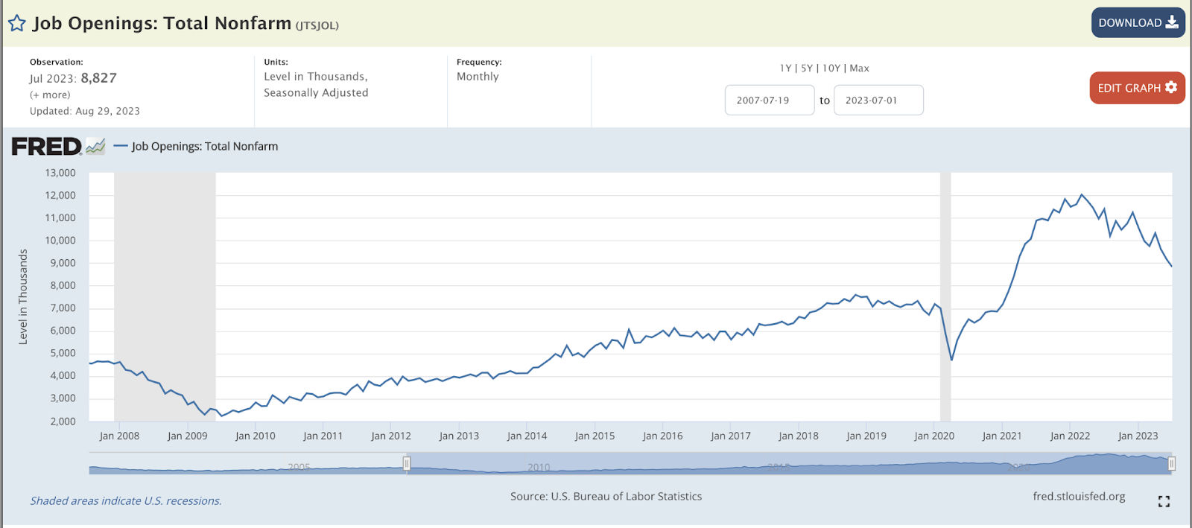
Important Context to understand our current Economic state
8

Slide 9
Prediction 1 : Recession expectations will continue to fall
The probability of any kind of recession (could be mild) in 12 months is essentially a coin flip
However, essentially all major banks have revised their economic outlooks and REDUCED the probability of a recession
Why has this happened? We have been looking at the wrong data: placing too much emphasis on the inverted yield curve.
Yield curves typically invert 15 months prior to recession meaning there would be a recession beginning in Oct 2023
Short term (less than 2 year T-Bills) are what the FED bought most of & what they are dumping.
Inverted yield curve could also Signals the expectation that inflation will decline.
Look at corporate R&D – a bullish indicator
9

Slide 10
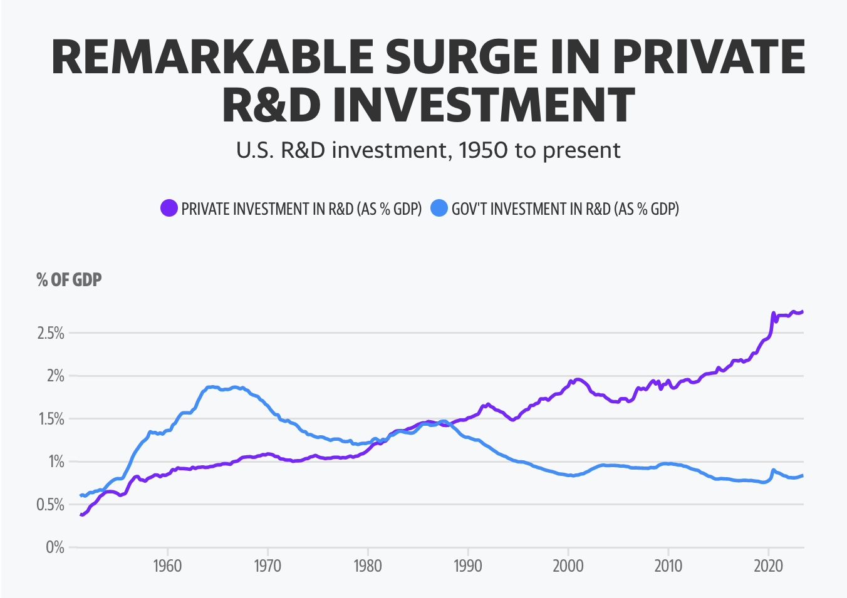
Prediction 1 : Recession expectations will continue to fall
10

Slide 11
Prediction 2: The best predictor of interest rates will be labor market data
Right now there are 10.9M job openings and approx. 8.2M job seekers
There are 2M more jobs than workers
This places upward pressure on wages
Work permits for foreigners would be deflationary
Additional advances in AI could be deflationary (I.E., if ChatGPT can replace jobs)
If the unemployment rate remains below 4%, there is a STRONG chance the FED will continue to hike rates
Recall, 4% is considered ”full employment” by most Economists
Trepp LLC.
11

Slide 12
Prediction 3: The FED target interest rate (Federal Funds rate) will remain essentially flat but interest rates on CRE will drop slightly.
Last week FED HELD RATES flat - in June they held flat and called it a “SKIP” then raised in July, but last week he didn’t call it a skip - he said he would continue to review the data.
"Shelter inflation posted a 7.3% year-over-year gain in August, compared to an overall 3.7% consumer inflation reading."
Listen for the term SUPERCORE” - if we hear this, then we know the FED understands. Supercore inflation excludes energy and housing prices from inflation data.
As lenders see resilience in the CRE market, lending standards will slightly loosen and the spread between long term treasuries and CRE mortgages will fall. In other words, lenders will not demand the risk premium they are now.
12

Slide 13
Prediction 4: Housing prices will not fall
Supply will not increase given how high materials, labor and debt costs are
The under supply of homes is so chronic (and the current mortgage rates make moving so difficult) that prices will remain elevated.
Multifamily construction starts are at a 39 month low (and down 42% year on year)
Even though there have been record numbers of apartments built, the quantity of units renting for $600-1100/mo. has decreased.
We are currently delivering new homes at the same pace as we were in 1995
If you look at the hours the median worker needs to work in order to purchase a product, housing is one of the few goods that has not fallen
Why is this? I believe it is because the margins for innovation are limited – there are not technologies that can be substitutes for physical space.
13

Slide 14
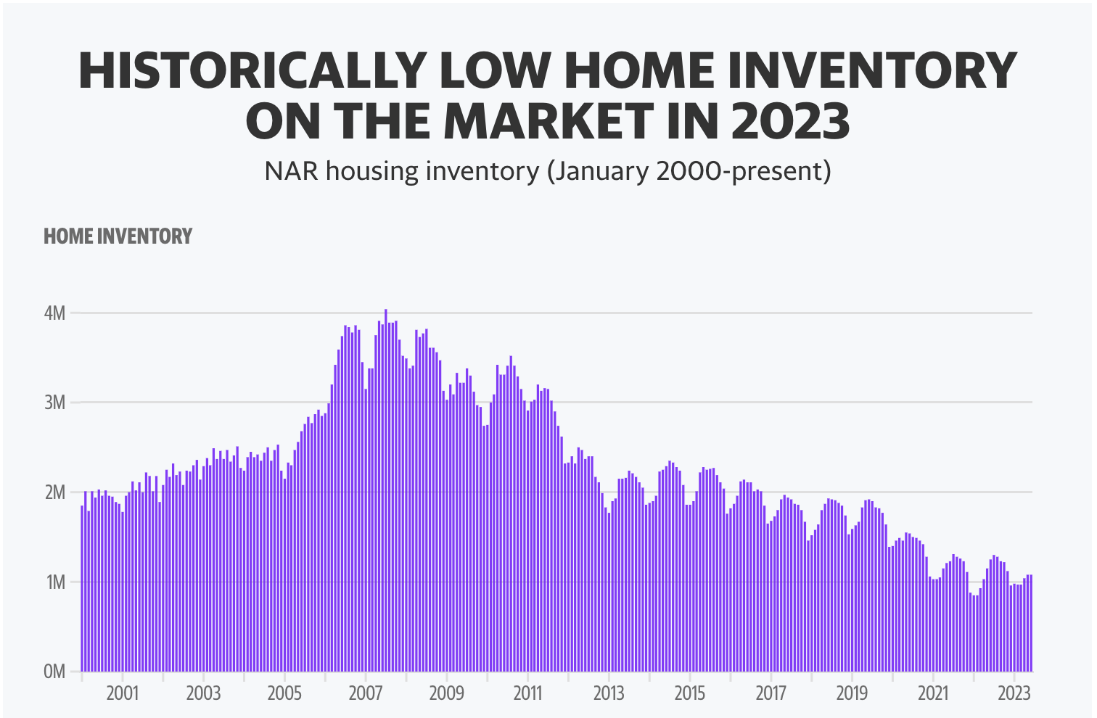
Prediction 4: Housing prices will not fall
14

Slide 15
Prediction 4: Construction costs will not fall
The tight labor market causes construction labor to remain elevated – especially when you can go to an Amazon Wearhouse or Inn & Out burger in start off making $24/hr.
Even in light of rising construction costs, permitting times are up over 70% since last year.
As labor and materials cost remain elevated, developers will favor upper scale multifamily developments as opposed to workforce housing.
Trepp LLC.
15

Slide 16
What strategies make sense given these predictions?
1) Policy work : the time is right to lobby local governments for more flexibility on zoning, zoning requirements and for permitting adaptive re-use (like hotel conversion to multifamily since these require no government monies and increase the stock of affordable housing)
2) Hospitality : There is $161B of Hospitality debt maturing & increased labor costs really hurt them, as do construction costs (because of mandatory PIPs) , combined with the fact that business travel has not rebounded to pre-covid levels means there will be increasing opportunity
Small Multifamily
Office will be cheap but price does not heal all wounds – don’t fall for a “value trap”
3) Look for Mom & Pop owners: those who own 10 properties or fewer collectively own 41% of all residential housing.
16

Slide 17
Reality & Strategy: The Economic Reality of 2023 & Why I’m focused on the Hotel Conversion Strategy

Slide 18
“The Role of a leader is to define reality and give hope” –Napoleon Bonaparte
Our Economic environment is uncertain
We need a strategy to match both the environment, our resources and our capabilities.
18

Slide 19
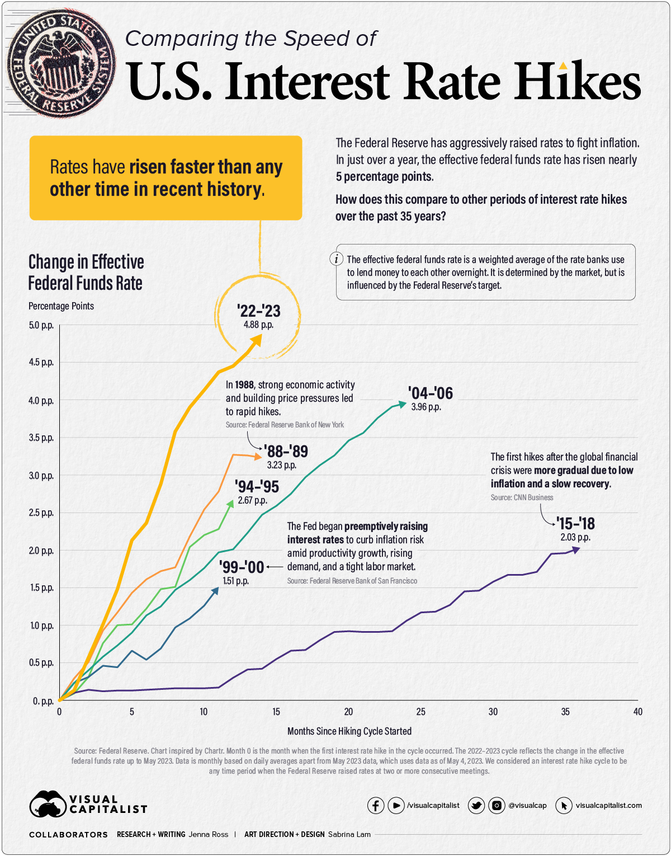
19

Slide 20
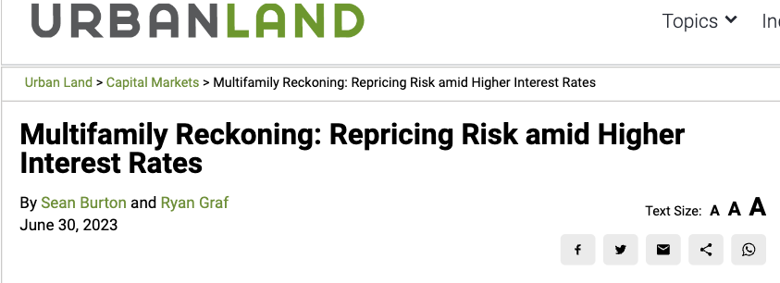
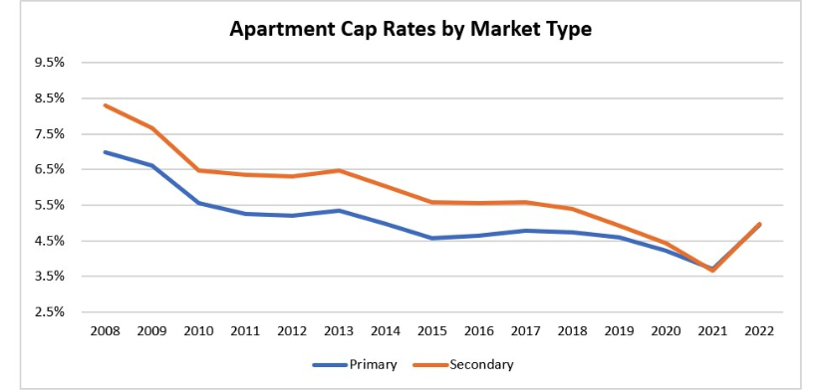
Reality: For over a decade, everyone made money in multifamily
Debt was cheap
Governments spent like wildfire
Leverage increased
CAP rates have been falling
Investors looked for riskier
deals
20

Slide 21
Reality: Right now many people are pausing, but not because they want to
In Q1 2023, Fannie Mae loan volume fell 36% YOY
In Q1 2023 Freddie Mac loan volume fell 60% YOY
Note – only about 25% of this agency debt is for acquisitions.
Inflation leads to higher property taxes, labor costs, construction material costs & in many markets insurance rates have more than doubled.
Capital sources dwindling – significantly fewer bridge lenders exists
"The failures of Silicon Valley Bank, First Republic Bank and Signature Bank have collectively totaled $548.5 billion in total assets, which is more than 2008 and 2009 combined when 165 banks failed, affecting more than $544 billion in total assets.”
According to Co-Star Q1 of 2023 , saw 74% less multifamily sales volume than Q1 2022 - the largest drop in 14 years!
21

Slide 22
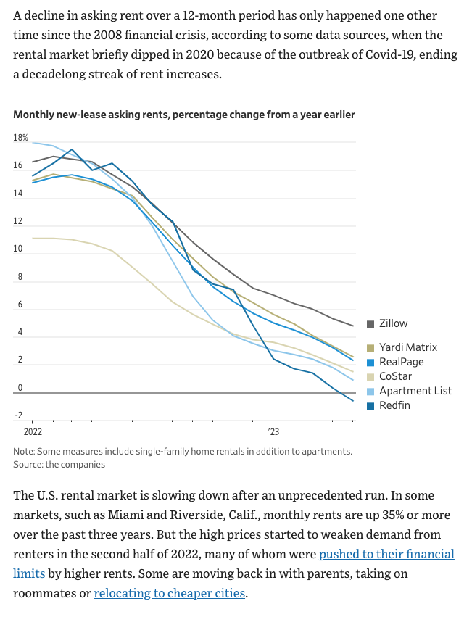
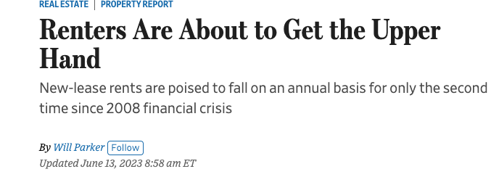
22

Slide 23
Reality: Cracks are starting to show
In April 2023 Applesway Investment defaulted on a $230M mortgage secured by 3200 units.
Veritas defaulted on $450 million dollar loan secured by their apartment portfolio
Even Blackstone is negotiating with their lender after failing to satisfy DSCR requirements on NYC properties (where rents are at record highs)
“A record $151.8 billion in U.S. mortgages backed by rental apartment buildings are set to expire this year, and $940.1 billion are set to expire over the next five years” WSJ
“There is $37 billion worth of securitized multifamily loans set to expire in the next two years where rental income either isn’t enough to cover debt payments, or covers it with less cushion than is considered standard” (this is 2x amount of at-risk office debt). WSJfirm Trepp LLC.
23

Slide 24
What is our fundamental goal as active investors
We want to “outperform” or generate “Alpha”
Efficient market hypothesis: when new information comes into the market, it is immediately reflected in stock prices and thus neither technical nor fundamental analysis can generate excess returns.
“Eighty-four percent of active managers underperform benchmarks after five years. That jumps to 90% after 10 years, and 95% after 20 years.”
(https://www.cnbc.com/2022/09/28/many-large-cap-active-managers-are-beating-their-benchmarks-despite-2022s-market-tumult.html)
If we are going to outperform we have to have an edge and be relentlessly focused on maintaining it.
Real-estate is a good place to try to outperform.
24

Slide 25
Translate reality into strategy: learn to put a number (price) on every problem
Let me tell you about when I first heard about the hotel conversion strategy – I thought it sounded extremely complicated – but then I started putting prices on all the complicated parts to see if the juice was worth the squeeze
Key Lesson here: Don’t use principles to answer what are fundamentally empirical questions.
25

Slide 26
Vilicus Capital is laser focused on the hotel conversion strategy and believe it will be the best risk adjusted multifamily investment for years to come.
I will show you 8 reasons why Hotel Conversions are even BETTER investments than traditional apartment buildings.
Here are 8 reasons why I like traditional multifamily:
26

Slide 27
Growing demand
Opportunity to use creative financing to acquire properties and scale
Valuation based on CAP rate (operators' performance)
Options for long term debt
Resilient to technology market disruptors
Recession resistant & countercyclical
Monthly cashflow
Opportunity to improve customers lives
27

Slide 28
Growing Demand
A general note: anyone making confident predictions about economics is someone you should be skeptical of. Hence, we need an investment strategy that has long term macroeconomic tailwinds.
High construction costs are reducing building
Increasing household formation is increasing demand for apartments
High interest rates are increasing demand for apartments (accidental landlords)
Value add investors are reducing the supply of affordable housing.
28

Slide 29
29

Slide 30
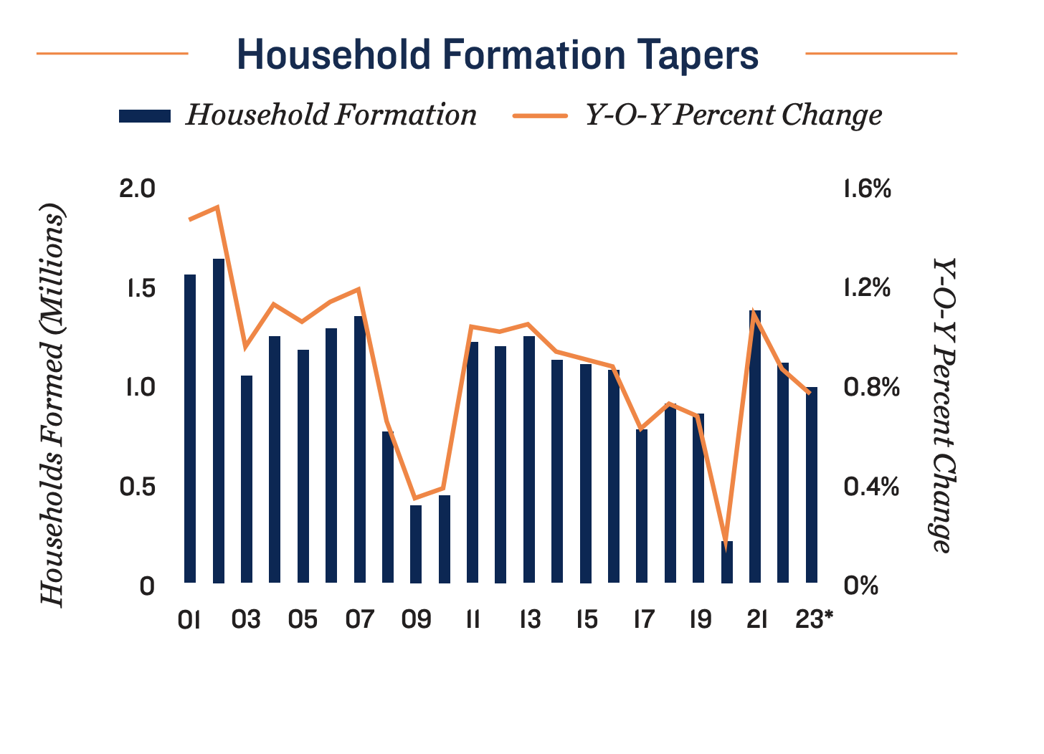
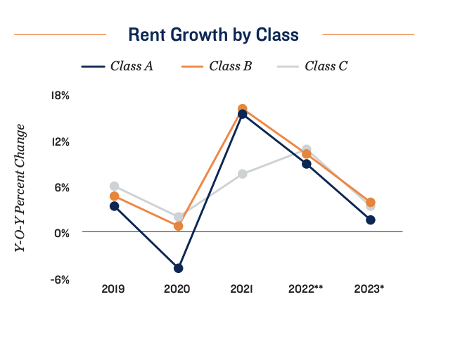
Growing Demand
30

Slide 31
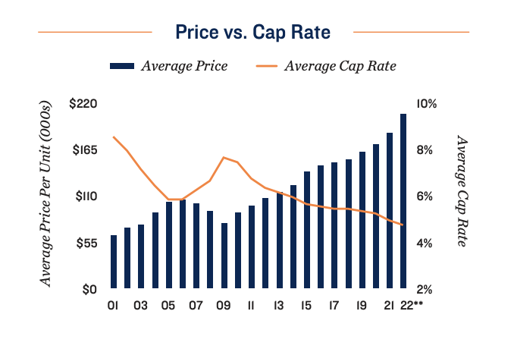
Growing Demand
31

Slide 32
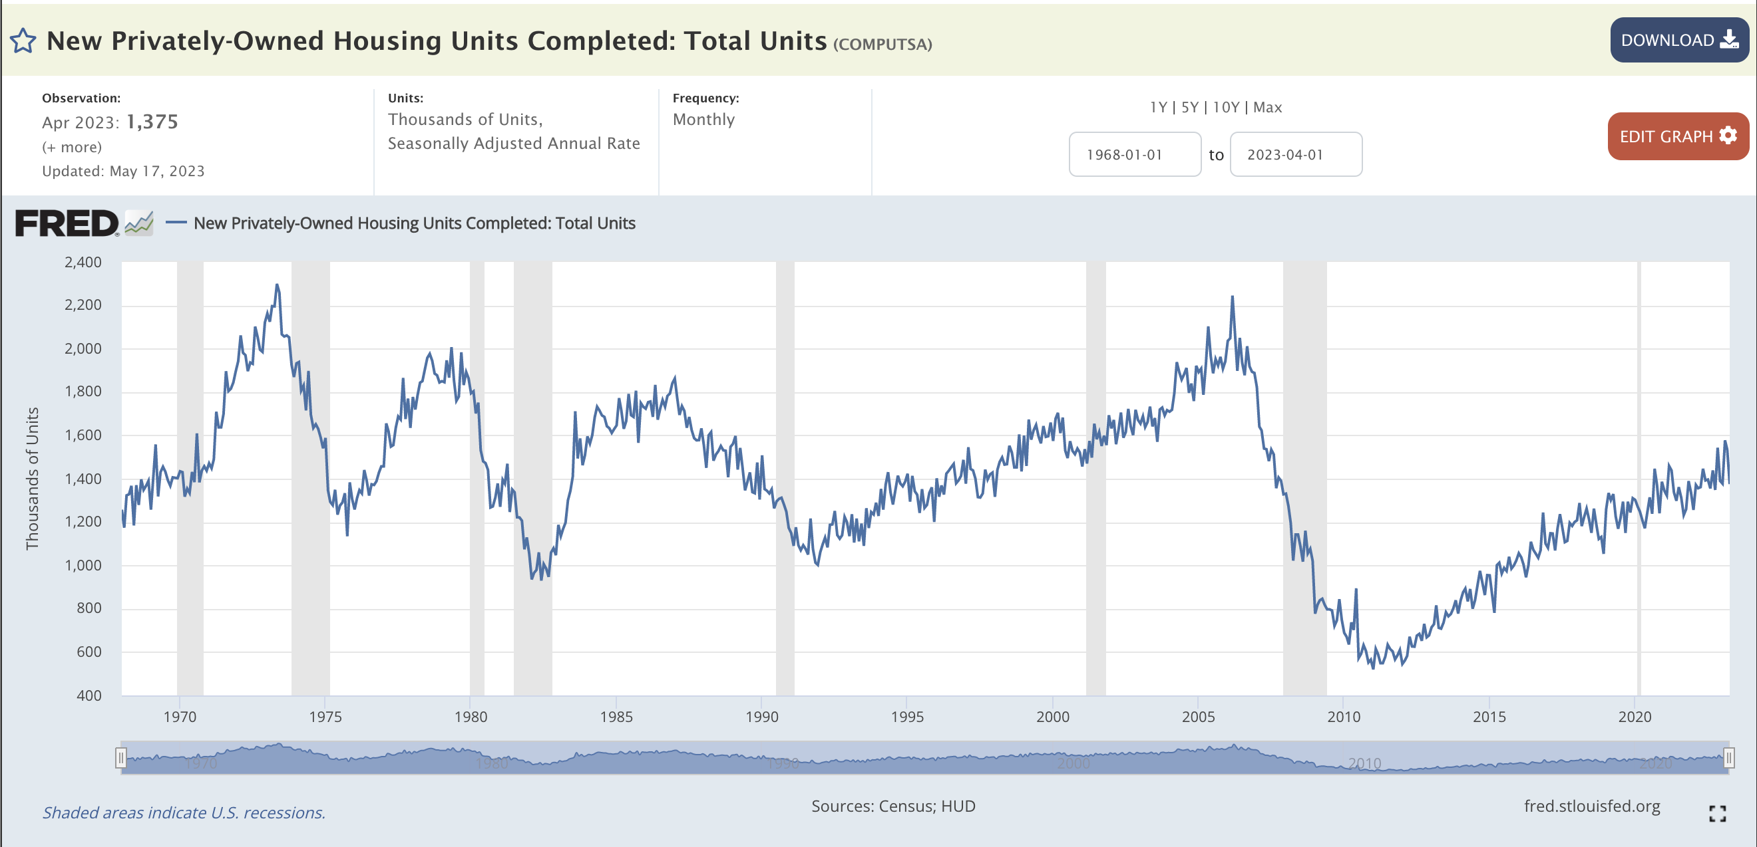
“Countercyclical” & Decreasing Supply
32

Slide 33
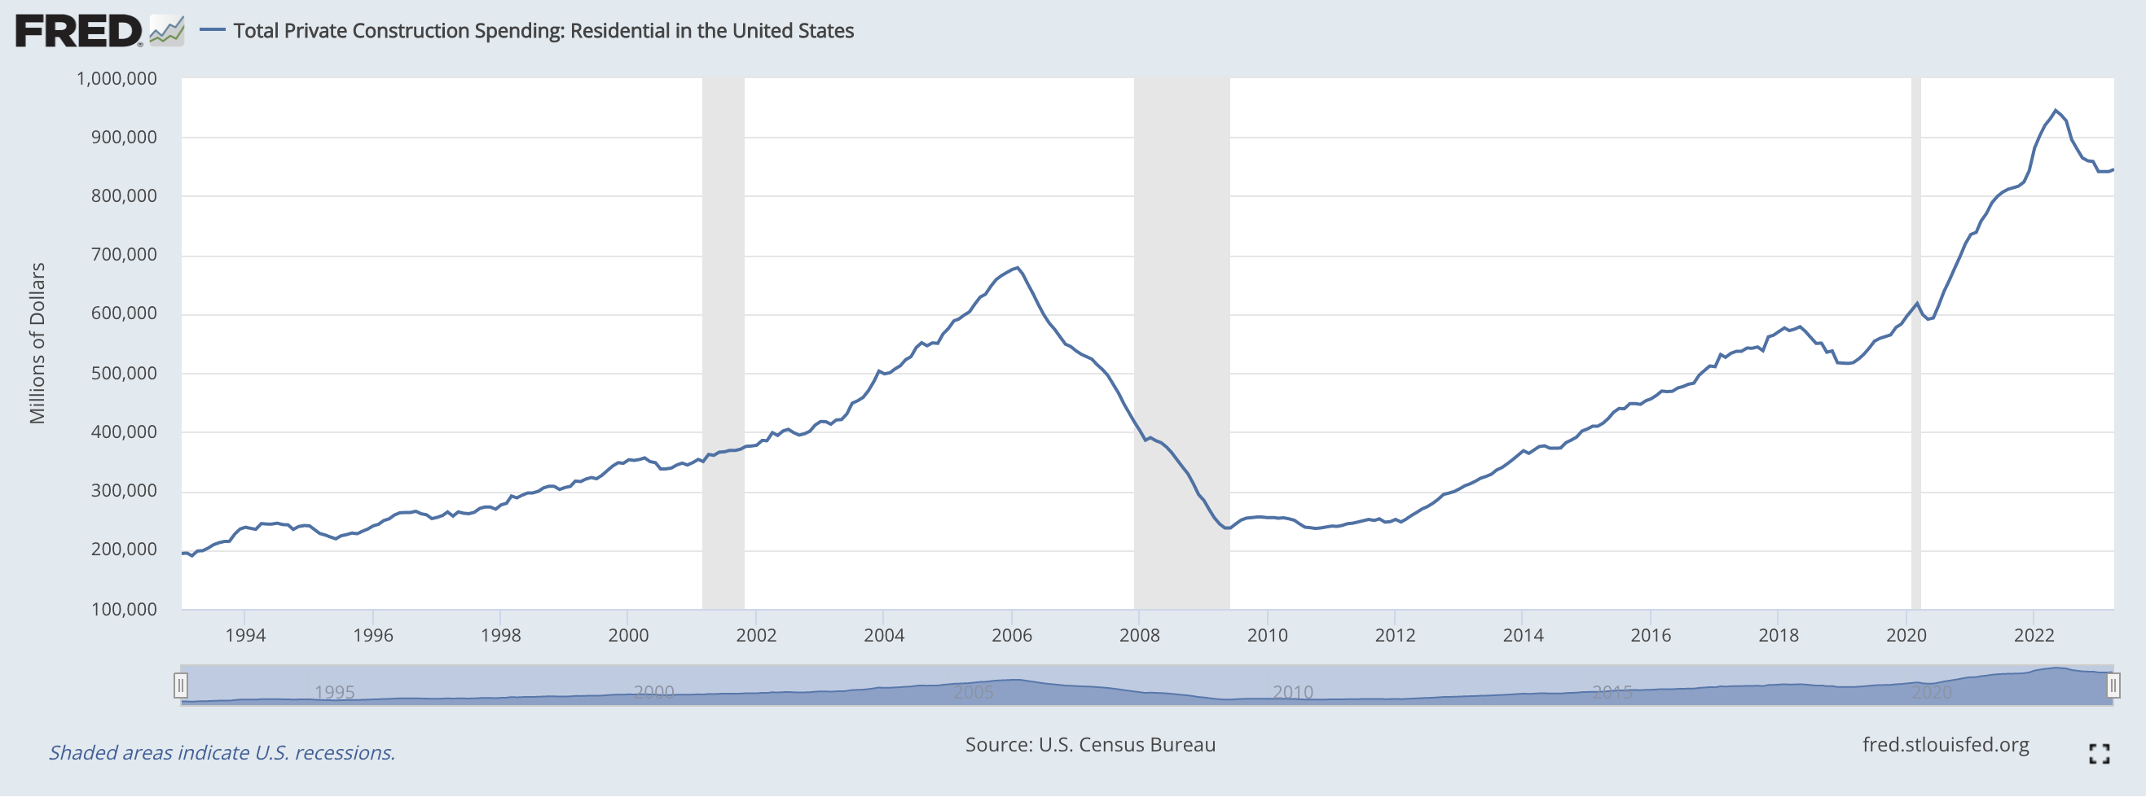
“Countercyclical” & Decreasing Supply
33

Slide 34
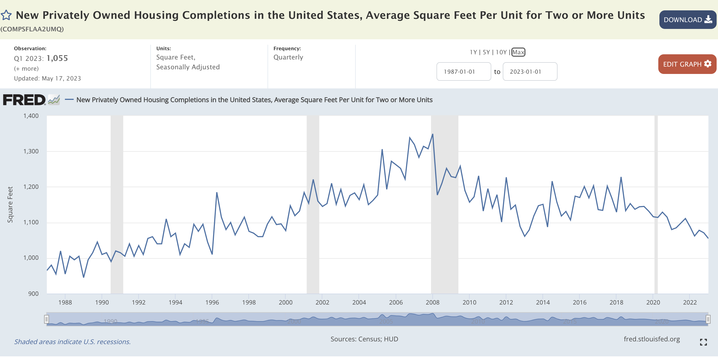
“Countercyclical” & Decreasing Supply
34

Slide 35
Single-family starts, at an annualized 892,000 homes, were down 18.5% from a year earlier.
“Countercyclical” & Decreasing Supply
Single-family starts, at an annualized 892,000 homes, were down 18.5% from a year earlier. WSJ
35

Slide 36
Why do developers prefer A and B class apartments over class C ?
The same reason the best oranges are not in Florida : the third law of demand (Alchian-Allen Effect)
“It states that when the prices of two substitute goods, such as high and low grades of the same product, are both increased by a fixed per-unit amount such as a transportation cost or a lump-sum tax, consumption will shift toward the higher-grade product.”
In other words, labor costs are the same for doing plumbing, electrical work, painting , etc., for C and A class properties; hence, developing A class becomes relatively cheaper as the fixed costs of development rise.
Because construction costs likely will not fall, C class housing will be chronically undersupplied.
Average income of renters is rising
Accidental Landlords (99% of current mortgages are under 6%)
36

Slide 37
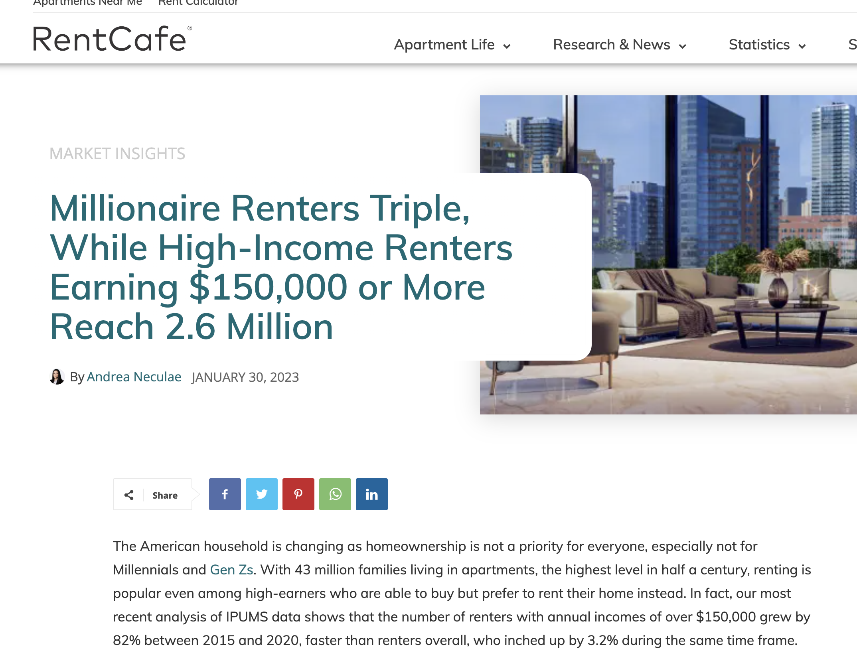
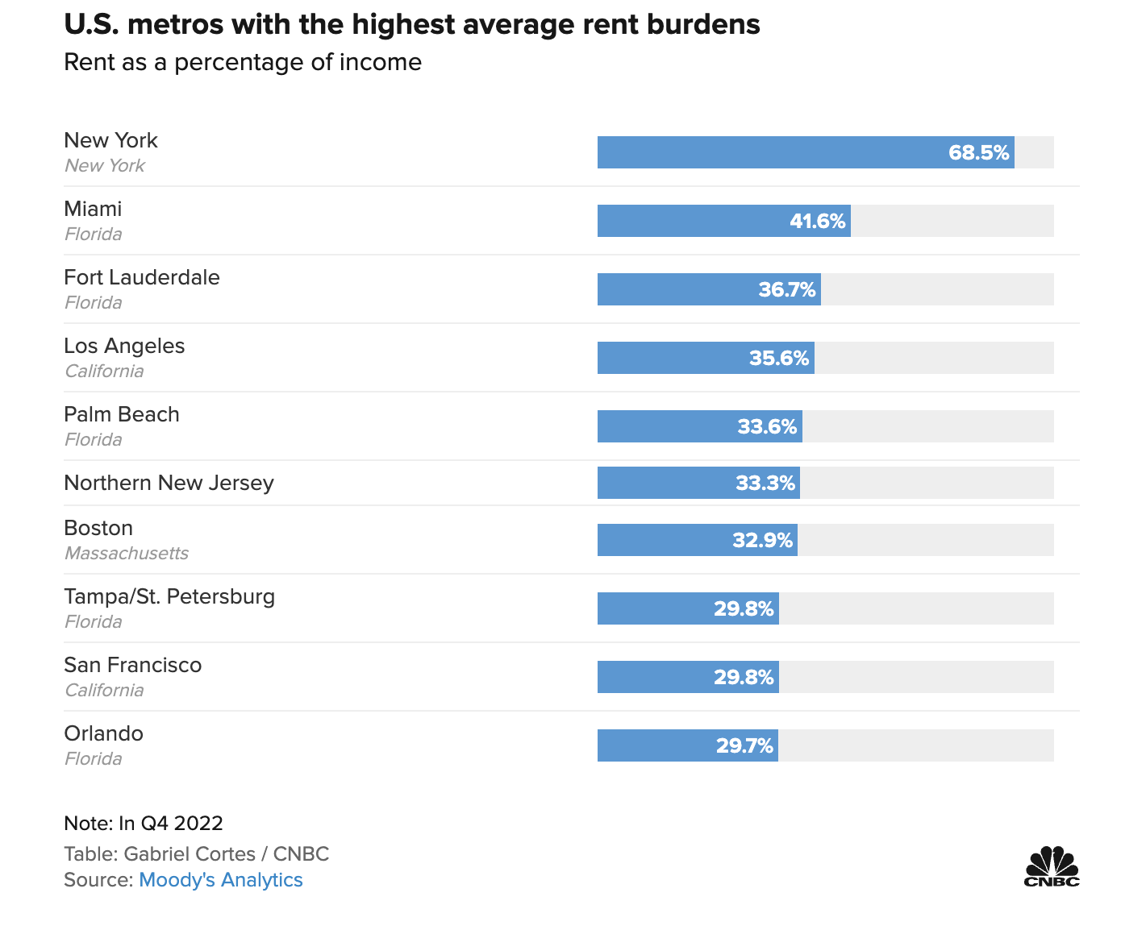
Why does this matter for our strategy? “Crowding down”
37

Slide 38
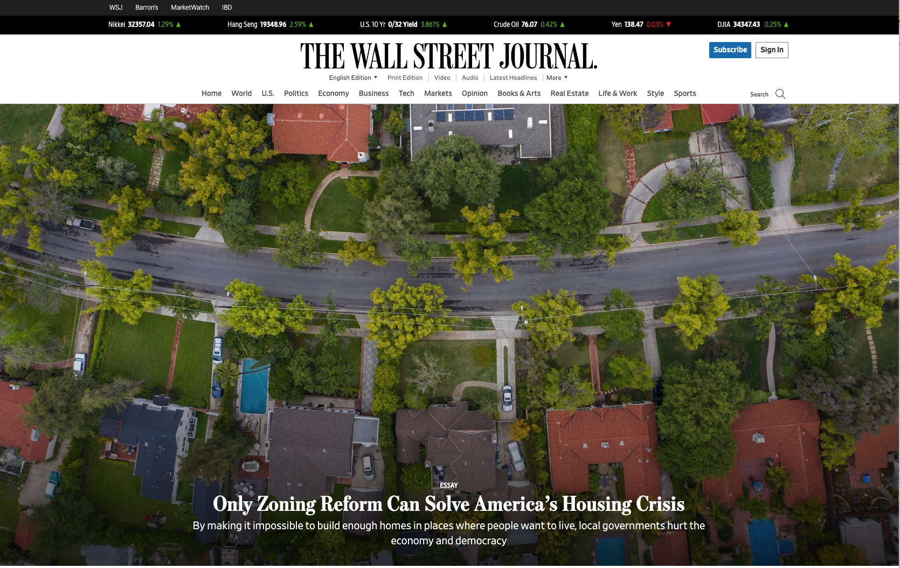
38

Slide 39
But, what if single family home values collapse?
I don’t think they will , here are some charts to contrast with the 07-08 crash
39

Slide 40
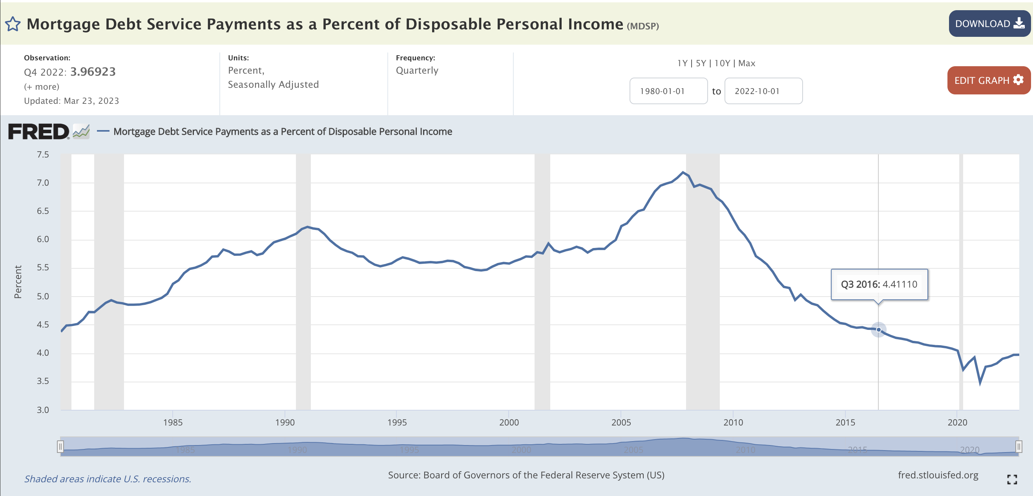
40

Slide 41
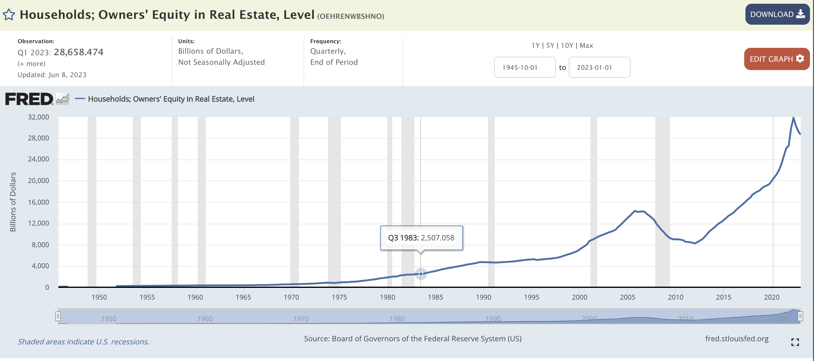
41

Slide 42
Multifamily has been historically insulated from technological change:
What technology can Apple or Google create to destroy demand for physical space like an apartment? Probably nothing.
Hotel conversions have a MOAT stronger than traditional multifamily
“The term "economic moat," popularized by Warren Buffett, refers to a business's ability to maintain competitive advantages over its competitors in order to protect its long-term profits and market share. Just like a medieval castle, the moat serves to protect those inside the fortress and their riches from outsiders.”
42

Slide 43
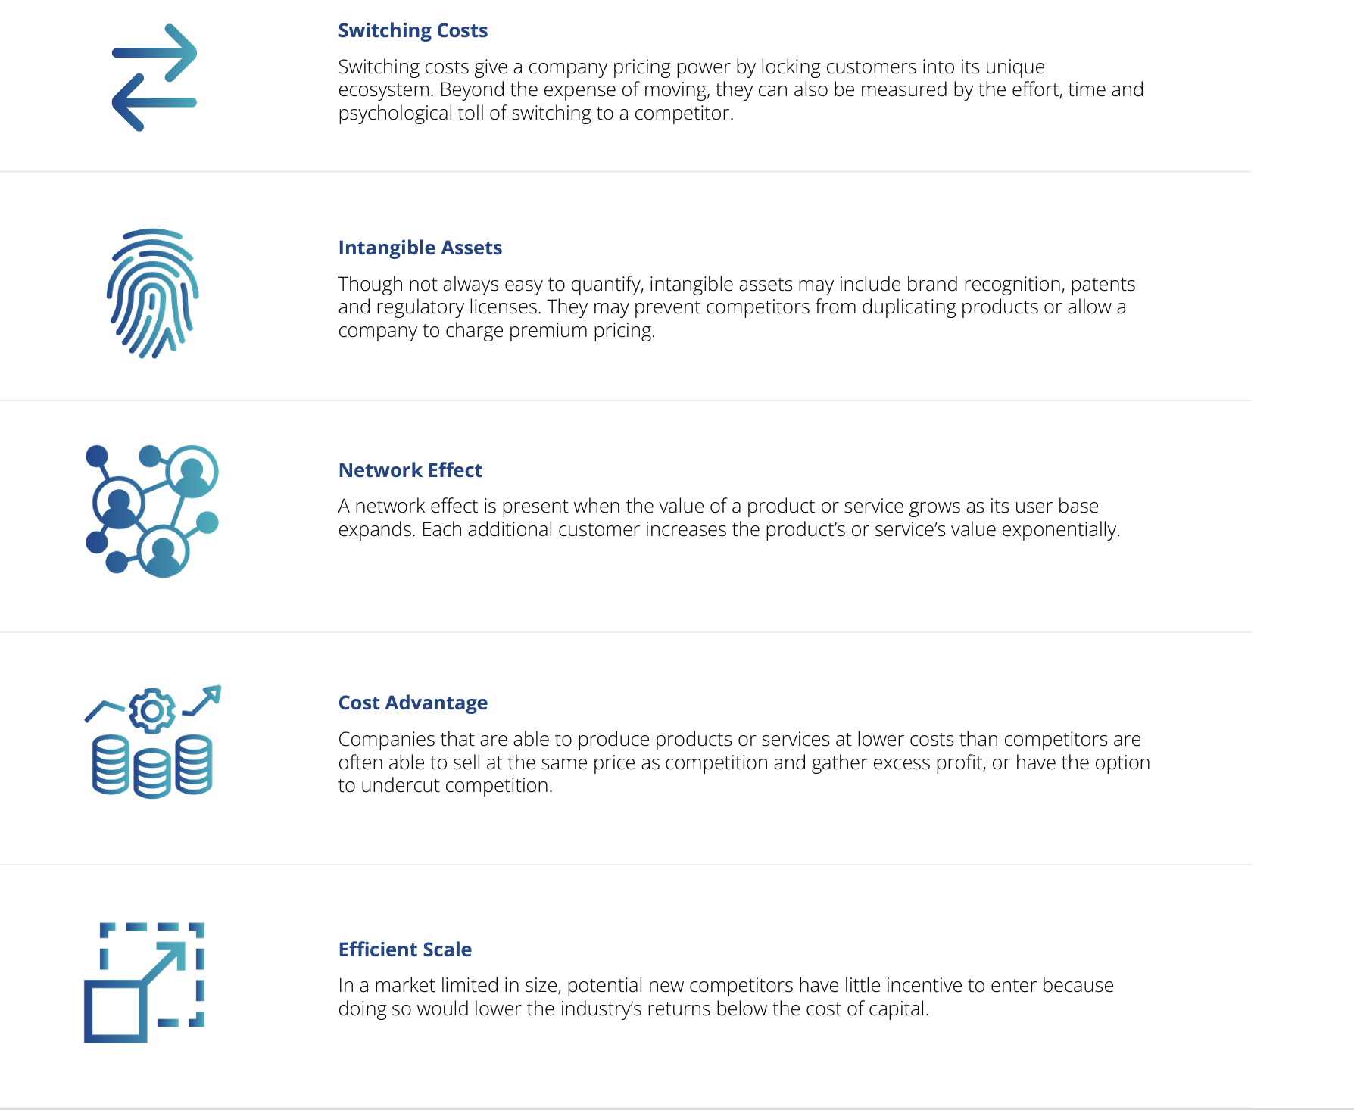
43

Slide 44
Opportunity to Use Creative Financing
It can be difficult to secure permanent debt at acquisition
However, some lenders recognize you are buying the asset far below its stabilized value.
If you buy below stabilized value, you can get high leverage (and even money for rehab costs)
Because the hospitality market is a buyer's market, sellers can be pushed to carry paper in second position.
It is still hard to have a capital stack without equity because you need reserves during stabilization period.
44

Slide 45
CAP Rate Compression: this is a financial conversion and a physical conversion
Hotels typically trade on revenue because profitability is heavily dependent on management performance.
However, if traded on a cap rate they are in the low to mid teens.
Major multifamily markets trade for 5-6% and sometimes 6-8% for C class.
The CAP rate compression is the source of BOTH high upside and limited downside.
Recall, caprates can rise on multifamily, but it would be extremely unlikely for this to happen on a hotel conversion
45

Slide 46
A slight Detour: Don’t fall for the “Resulting Bias” when evaluating other operators
46

Slide 47
Long term debt options
Fannie Mae and Freddie Mac are obligated to loan money to multifamily operators (approximately $450B per year)
There is no equivalent for hotel owners
Freddie Mac properties get priced based on an “affordability score” - class C properties will can get better terms than class B.
47

Slide 48
Monthly cashflow
Opportunity to operate as both extended stay and multifamily
High occupancy rates
Lower turnover rates
Opportunity to bill for insurance, internet, and other amenities – all of which increase the NOI.
48

Slide 49
Opportunity to better tenants’ lives
Let me tell you why I decided to study & teach Economics
We don’t want young people to think the economy is rigged against them
Creating more affordable housing motivates us – what will cause you to keep going when things go wrong?
We want to help people live a life beyond their 5 senses.
49

Slide 50
Growing demand- especially for workforce housing and falling supply
Opportunity to use creative financing– easier buy at a discount relative to stabilized value
Valuation based on CAP rate – CAP rate compression means more upside limited downside
Options for long term debt – Agency loans must be made each year & high affordability scores
Resilient to technology market disruptors- Natural moat via construction costs
Recession resistant & countercyclical – an inferior good
Monthly cashflow – additional opportunities for cashflow via add on services
Opportunity to improve customers lives – provide a badly needed product via free markets
50

Slide 51
We are at the beginning!
https://www.hospitalitynet.org/opinion/4115884.html
51

Slide 52
Rules of Thumb & Targets
If hotel has over 80 rooms, we need to operate as a hotel during lease up
Look for for the death spiral (sub $50 ADR)
Cost per kitchen $8000-$12000
Lease up rate of 8-12 units / mo
20 rooms per housekeeper
$3 - $4 /sq ft for fire installation
120-day DD period with option to extend
Ideally 20% IRR with 8% Exit CAP (maybe 7%)
Minimum total income per unit $750
52

Slide 53
Population growth
Growing employment rates & diversity of employment options
Promising Market Area
It’s crucial to locate the most future-proof area. We were analyzing historical data to identify trends that support the following points.
Rising Home Prices and Rising Rents
An MSA population of at least 1 million
53

Slide 54
Example of a market we like– Houston TX
26
3rd
6.6
15%
X
Fortune 500 Corporate Headquarters
fastest growing city, by population, in the USA
Million MSA population
Rent growth during 2020-2022
Houston does not have zoning laws
54

Slide 55
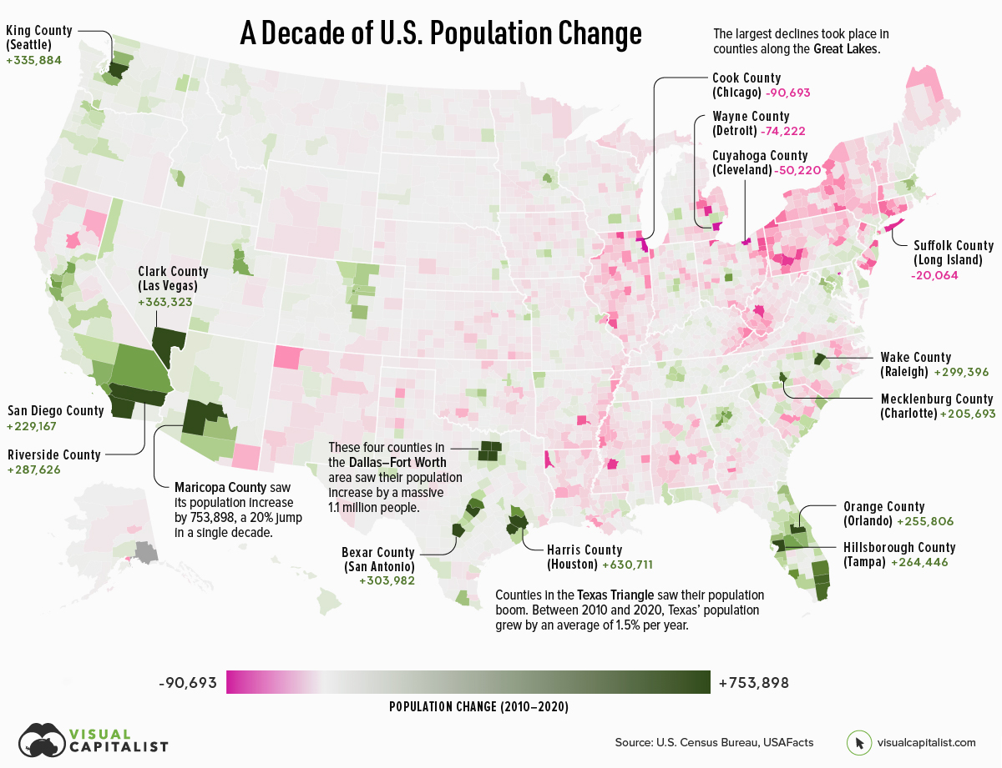
55

Slide 56
What are the Challenges for Hotel Conversion?
Loan Guarantors
Manager for Both hotel and apartments during stabilization – operations are complicated
Insurance (blended coverage)
Getting clear answers on property taxes
Awareness & partnerships
56

Slide 57
Range:
Just because it is familiar does not mean it is safe.
The tools that got you here are not necessarily the tools that will get you where you want to go.
57

Slide 58
Scan the QR code to sign up for the Vilicus Capital newsletter
We send out regular emails on:
Real estate economics
new investment offerings for both passive investment and active partnership.
AlexCartwright@vilicus.capital
WWW.VILICUS.CAPITAL

